Slide 1
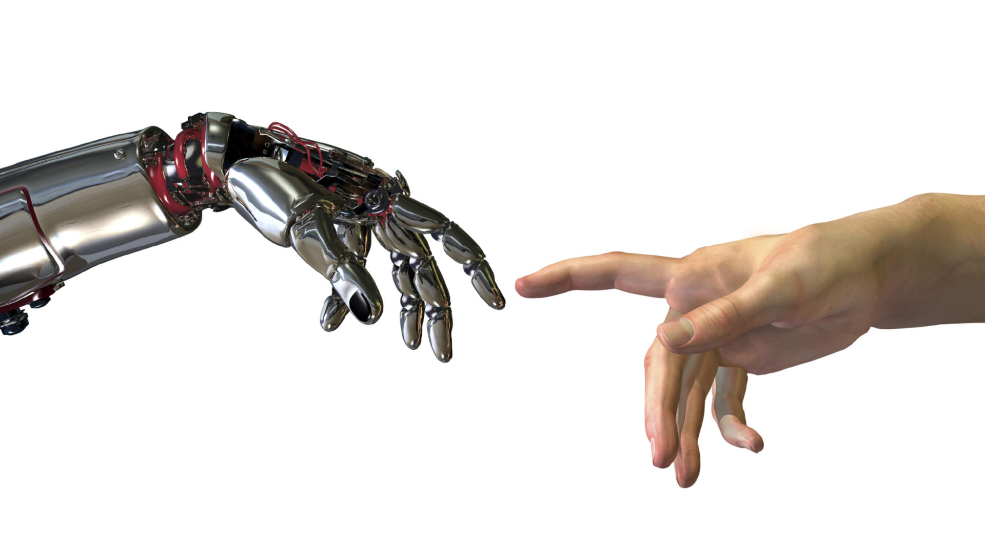
Robots & People

Slide 2
Today’s program
Learn about Robots
What are they?
Types?
What can they do?
How do they affect our lives?

Slide 3
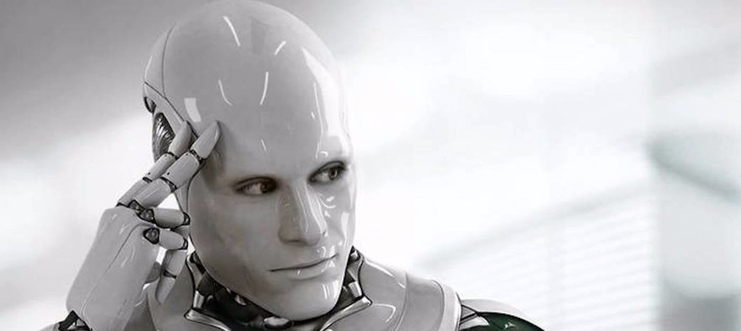
What is a Robot?

Slide 4
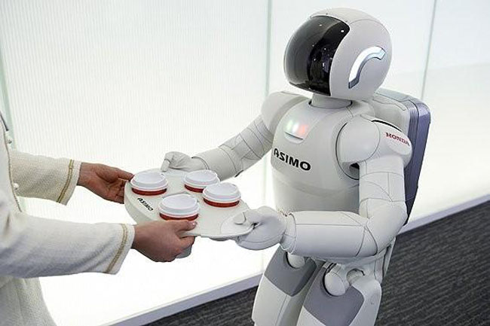
Robots are machines that can sense, plan, and act

Slide 5
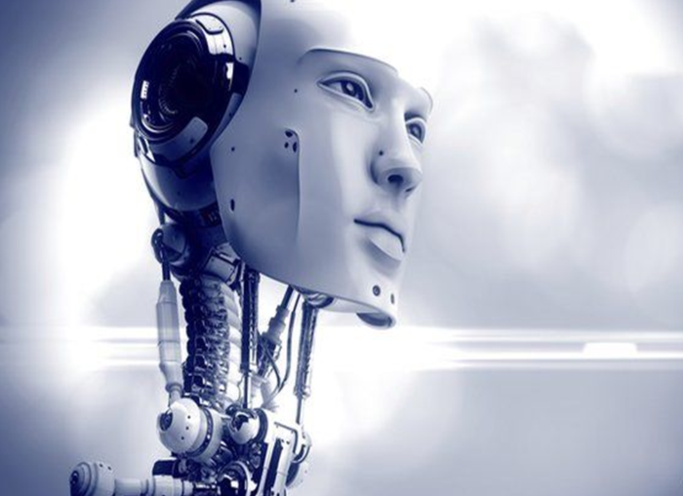
Types of Robots

Slide 6
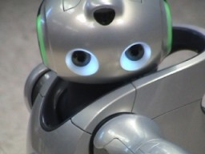
QRIO
Made by: Sony Height: 61cm Pronounced “curio” the name stands for “quest for curiosity” in Japanese.
Purpose: To live with you, make life fun and make you happy.
What can it do? Walk, talk, run, dance, recognize voices and faces, play ball games and surf the web.

Slide 7
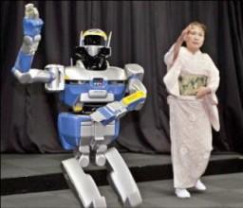
HR
Made by: Kawada Industries Height: 1.5m Weight: 58kg
Purpose: To work in human environments and use human tools.
What can it do? Walk, get up from awkward positions, walk on uneven surfaces and grasp objects.

Slide 8
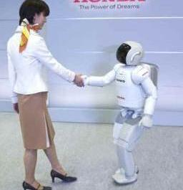
ASIMO
Made by: Honda Height: 1.2m ASIMO stands for: Advanced Step in Innovative Mobility, it also takes its name from robotic visionary Isaac Asimov.
Purpose: Began in 1986 as a study into human movement and has since evolved into a robot capable of a wide range of tasks.
What can it do? It can walk, run, turn corners, recognize hand gestures, carry objects, dance and climb up and down stairs.

Slide 9
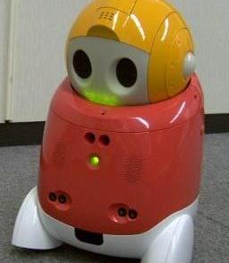
PaPeRo
Made by: NEC Height: 38cm PaPeRo stands for: Partner-type Personal Robot
Purpose: To both entertain and assist around the house.
What can it do? Recognizes speech, talks, moves, responds to users, controls household devices.

Slide 10
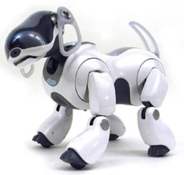
AIBO
Made by: Sony (Japan) Height: 27cm AIBO stands for: Artificial Intelligent Robot
AIBO features a variety of senses:
Touch - Feels human contact through sensors on head, back, chin & paws.
Hearing - Detects sound through a pair of stereo microphones, voice recognition.
Sight - Color camera, distance sensors and facial recognition.
Balance - Keeps balance through acceleration sensors.

Slide 11
What can robots do?

Slide 12
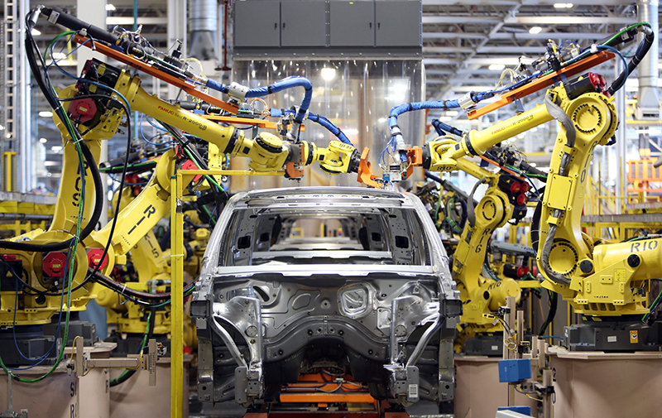
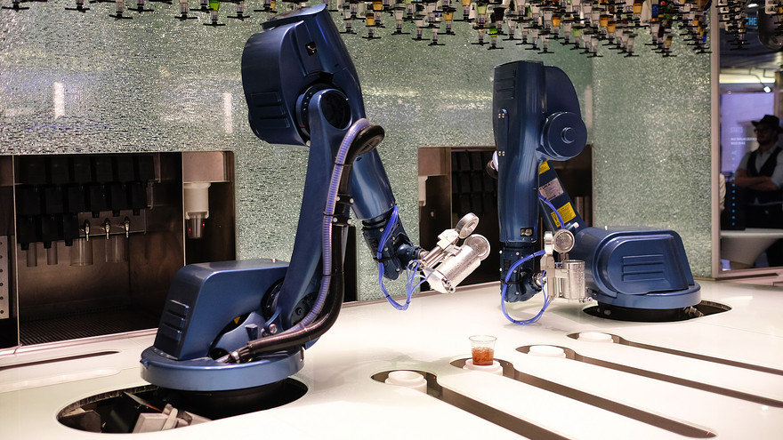
Work in a factory
Bartender

Slide 13
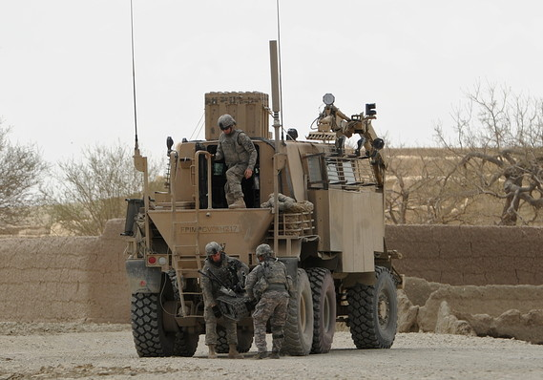
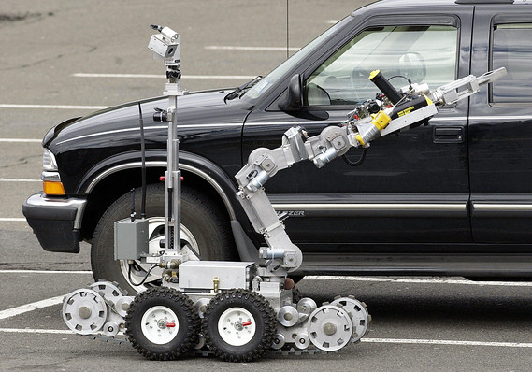
Soldier
Bomb Squad

Slide 14
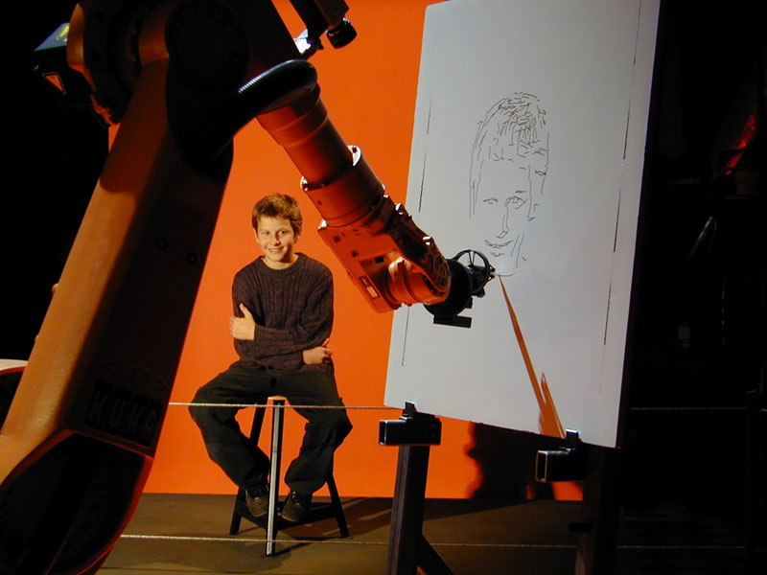
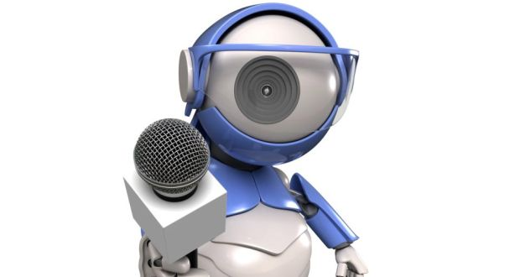
Draw portraits
Journalist

Slide 15
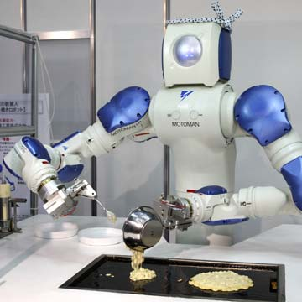
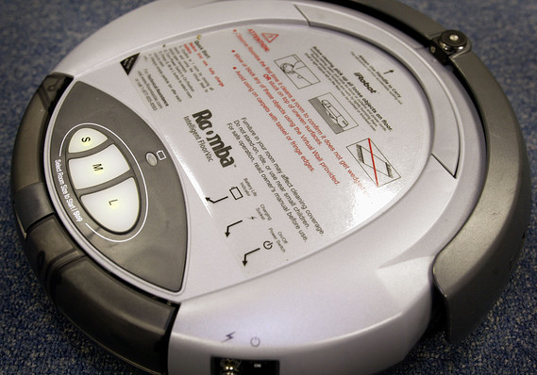
Cooking
Housekeeper

Slide 16
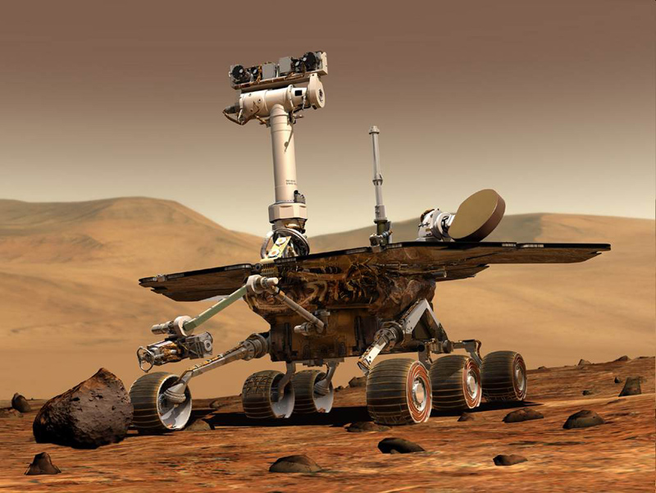
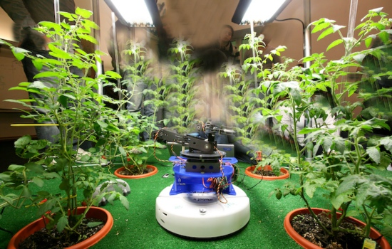
Explore space
Gardener

Slide 17
Disadvantages
Extremely high capital cost
High standard of maintenance required
Can Malfunction
Cannot think creatively
Precise programming needed (Time, training, specialist knowledge)
When computer systems failure will cause breakdown
Need a huge power supply
Replace human workers
Certain processes still need a skilled operator

Slide 18
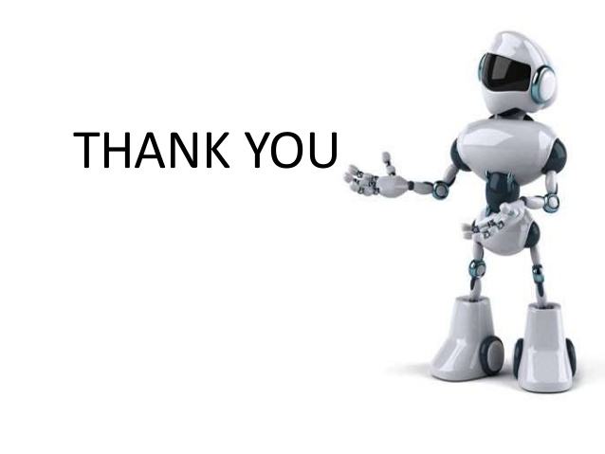

Slide 19
SUBMITTED BY
JOVITA D’SOUZA & DIVYA SANTHANAZ

